Slide 1


Web Analytics using Kafka
Purnima Kamath
@purnimakamath
https://www.linkedin.com/in/purnimakamath/
Director, Women Who Code Singapore
Evangelist YOW! Conference

Slide 2
Web Analytics using Kafka
Agenda
What do I mean by Web Analytics?
The 1st Problem
Kafka – What & How
Intro to Pub/Sub
Kafka intricacies
Streams!
The 2nd Problem
Demo

Slide 3



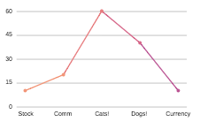


What is Web Analytics?
You
Client
Notes:
So, What is Web Analytics:
Lets assume that you are running a publishing company – You could be a -
NY Times publishing house
Blogger on Medium
Analyst at an Investment Bank
Publish articles – Send subscription emails
Collect who reads what
More cat videos?
More tech stock performance
Typically the capture is via HttpServers with a Database backend.
NOTE: This is a very simplistic diagram

Slide 4




The 1st Problem
Typical subscribers range in the 100,000’s
Volumes typically high for plain web servers to handle
Very high request drop rates because of request build up
Response times dictated by slower DB writes
Notes:
What are the problems that can happen –
The 1st Problem:
Typically HttpServers write to DB – SLOW!
Typical subscribers to articles – 100,000’s
What happens when/if all click at the same time –
Requests are dropped
Network clogged
Worse – Service goes down (Out of memory anyone?)
This was the problem I faced.

Slide 5


Enter Kafka!
A distributed commit log
Developed by engineers at Linked In
Throttles events by queuing them, to be processed later
Supports multiple producers and consumers (Pub/Sub)
Notes:
We needed a throttle – so that our DB can process saves slowly
We needed a throttle – so that our Http Server could just fire and forget.
Something that could support multiple concurrent requests
Developed by Linked In Engineers
Solution: Enter Kafka
NOTE: Simplistic diagram!!

Slide 6
What is Pub/Sub?
Queues/Topics in a Nutshell
IN
6
5
4
3
2
1
OUT
Most commonly used Enterprise Integration pattern
Guaranteed Ordering
Events remain on queue/topic unless read
Single subscriber (Queues)
Multiple Subscribers (Topics)
Cluster
Broker-1
T1
Broker-2
T2
Broker-3
T3
Notes:
So, how does Kafka throttle events?
It uses Publish/Subscribe pattern
Most commonly used Integration Pattern
Pub/Sub is achieved by Queues & Topics.
Coffee shop example – One queue & FCFS
Queues
Topics
Kafka relies on Pub/Sub – this is how it throttles events
It has its own memory to save existing requests in queue.

Slide 7
Kafka in depth
Distributed Commit Log
IN
101
100
5
4
3
2
1
OUT
102
Cluster
Partitioned
Replicated
Ordered
Clustered (Uses zookeeper)
Multiple subscribers via Consumer Groups
Commit log makes replays possible (consumer offsets)
Broker-1
T1
(Primary)
Consumer
Consumer Offsets
Consumer
Producer
Consumer
Broker-2
Producer
T1
(Replica)
Producer
T2
(Replica)
Consumer
Consumer
Broker-3
Consumer
T2
(Primary)
Consumer Offsets
Notes:
Kafka implement Pub/Sub – by implementing something called as a “Distributed Commit Log”
What is Distributed. Spread across multiple servers/CPUs. Analogy: Coffee Shop has multiple counters.
Why Distributed:
Failover
Backup
More throughput
Fault Tolerant
Distributed Commit Log –– What is Central Features of Kafka – Explain Each word
Explain Diagram
Broker,
Producer,
Consumer,
Topic
Clustered – Zookeeper
Ordered
Replicated
Multiple Producers and consumers

Slide 8
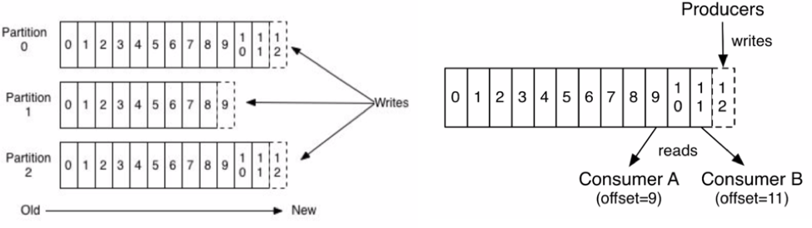
Kafka in depth
Partitions and Consumer Offsets are the best features of Kafka
Partitions can live on the same node or different nodes
Multiple consumers & producers can consume and produce simultaneously *
Consumer offsets are also replicated
Consumer offsets make replays possible
Source: confluent.io blog (see references slide)
Notes:
USP of Kafka – Partitions & Consumer offsets
We saw previously – Clustered & Replicated
Paritions:
RDBMS equivalent - Shards
Can live on same or multiple CPUs/hosts
Each partition can have individual producers and subscribers
Each partition can be replicated
Consumer Offsets:
Registers the position of consumption for a particular consumer group
Helps understand where we were in case of restarts
Helps in replays!! – Major advantage

Slide 9
Why do I like Kafka?
Is it different than say MQ or Tibco EMS?
Not very (Theoretically)
It’s a LOG!
Everything can be persisted
Easy to install
Open Source
ACK’s are easily configurable per Topic – Making it faster
Replays!
Notes:
With traditional queue systems: Expensive & time consuming to install new queues & topics
Here everything is persisted – unlike EMS.
Open Source!
ACK
Replays

Slide 10
The 2nd Problem
”Data Lake”
Cluster
Broker-1
T1
(Primary)
T2
(Replica)
Reader | Article Read | Read Time
Purnima | XyZ | 28th July 5pm
Marianne |  | 1st Aug 1pm
 | AbC | 10th July 2pm
T2
Broker-2
(Primary)
Analytics Data
Users Data
T1
(Replica)
T1
Broker-3
(Replica)
T2
(Replica)
Article/Blog Data
Notes:
Have you heard of ETL?
Those overnight batches which run to source data from various DBs into a “Data Lake”
Assume you wanted to build a analytics report of who read what – You need to source (1) Analytics captured (2) User Data/CRM (3) Blog Data into Data Lake
Problems:
What if article is deleted?
What if user unsubscribes or closes his account?

Slide 11
What are Kafka Streams?
Kafka achieves real time ETL (Extract Transform Load) using Streams.
Kafka Streams:
A stream is an ordered, replay-able, and fault-tolerant sequence of immutable data records
They represent an unbounded, continuously updating data set.
Client Side libraries
Real time (instead of normal ETL, happens over mid night)
Kafka Tables:
A table is an abstraction of a stream
Each record is an “update” to the streams data set
Client Side Libraries.
Notes:
We solved this problem using a Real Time ETL provided by Kafka Streams.
Streams are like ETL but real time. Extract and transform is done when data arrives
This is done Client Side
If you have used Reactive Streams before – this is similar – but more powerful. It can maintain state and has the capability of internal queues within Kafka to back it up.
Kafka tables are like views over a stream.
Note: This is not Netflix streaming!

Slide 12
What are Kafka Streams?
Cluster
Consumer
Consumer
Broker-1
Micro services
T1
(Primary)
KStreams
Consumer Offsets
Micro services
Broker-2
T1
(Replica)
T2
(Replica)
Broker-3
T2
(Primary)
Consumer Offsets
Article/Blog Data
Users Data
Notes:
Compare this diagram to the Data lake
This is simplistic.

Slide 13
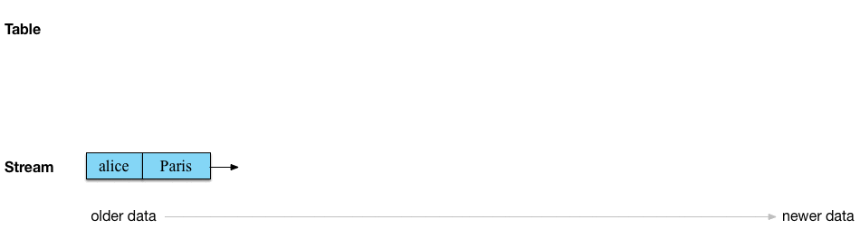
What are Kafka Streams?
A good explanation for stream table duality.
Source: Michael Noll’s blog (see further readings slide)

Slide 14
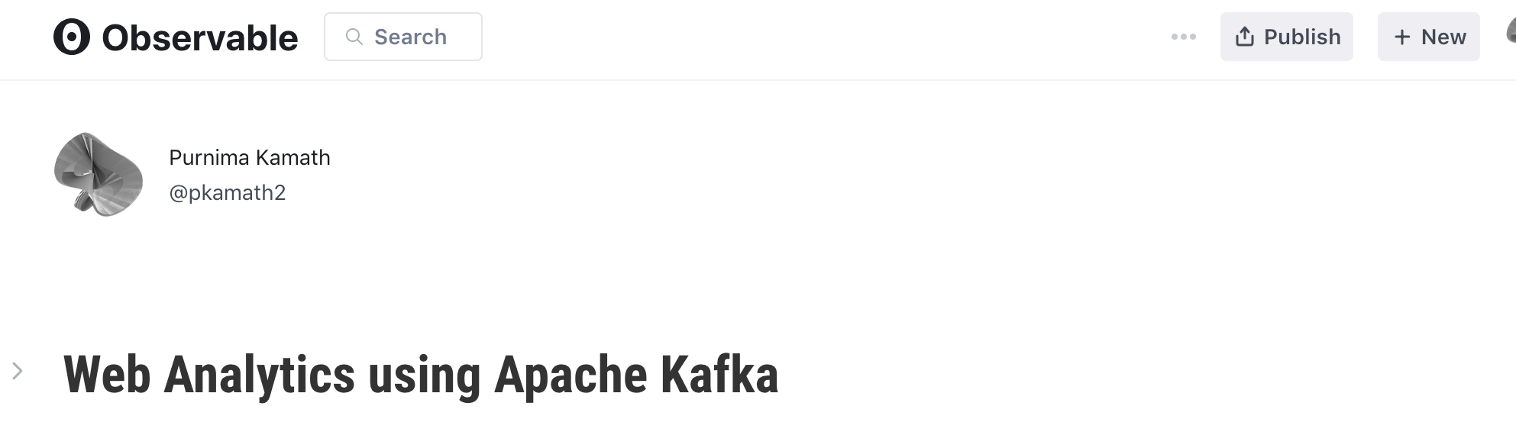
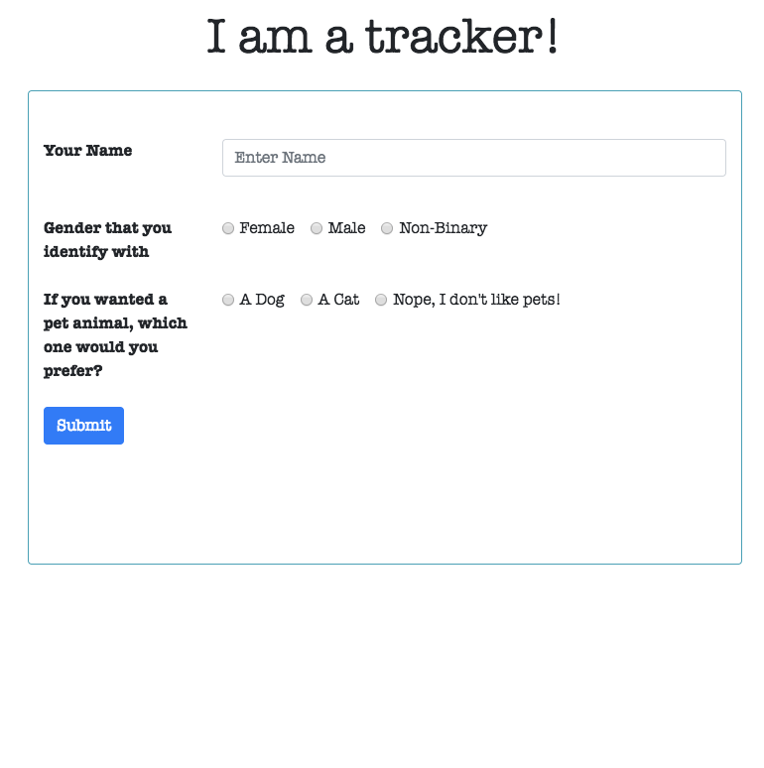
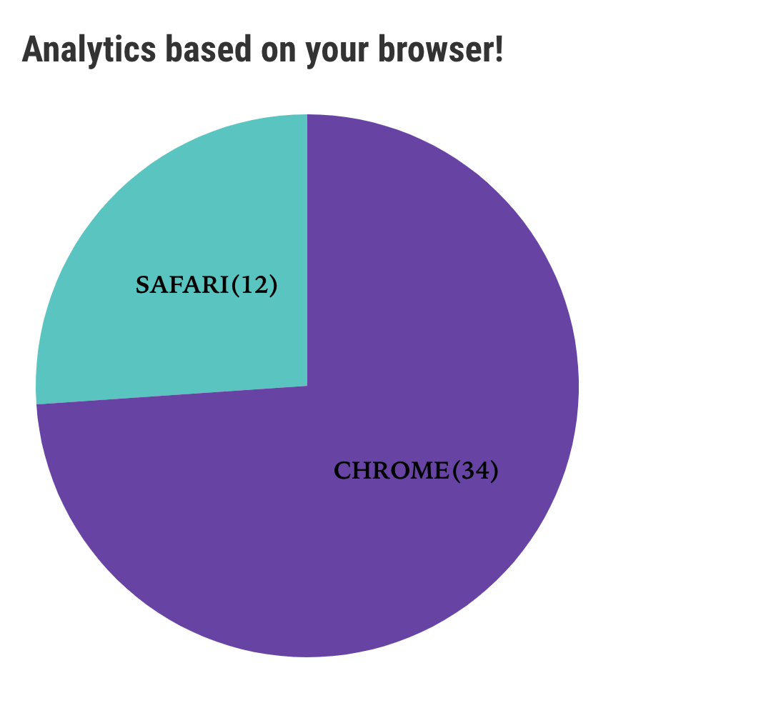
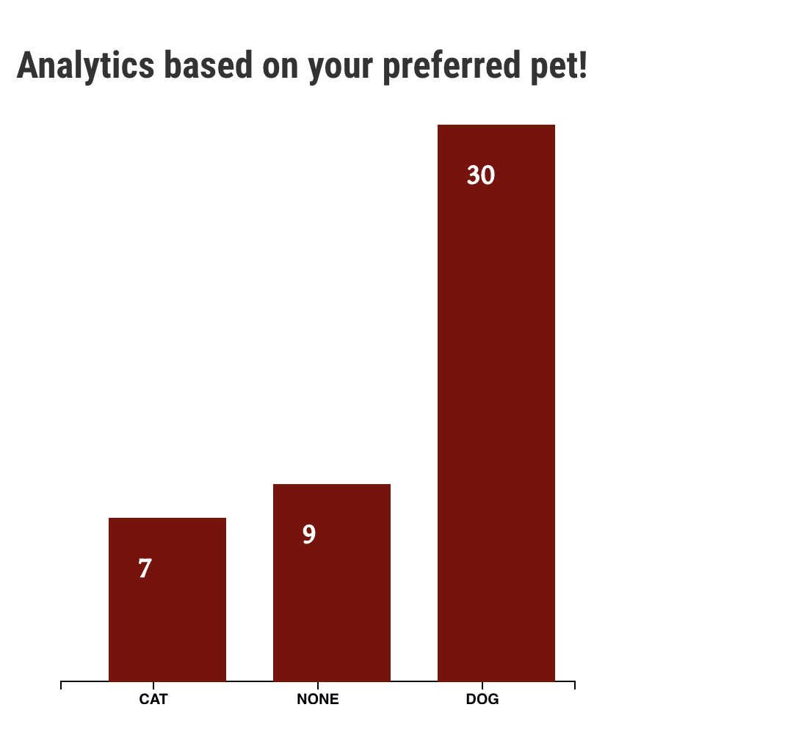
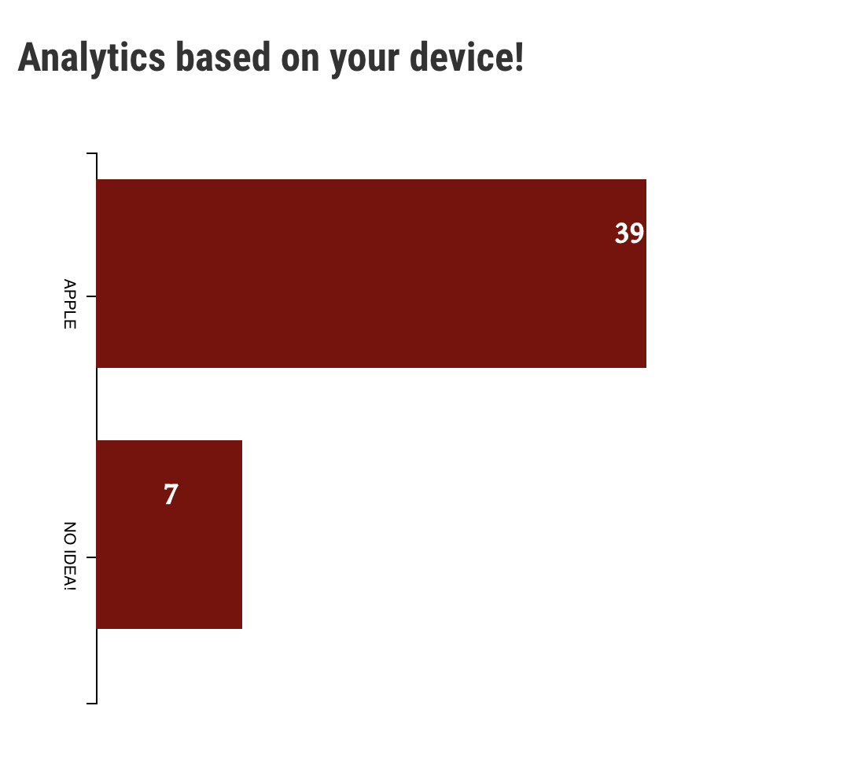
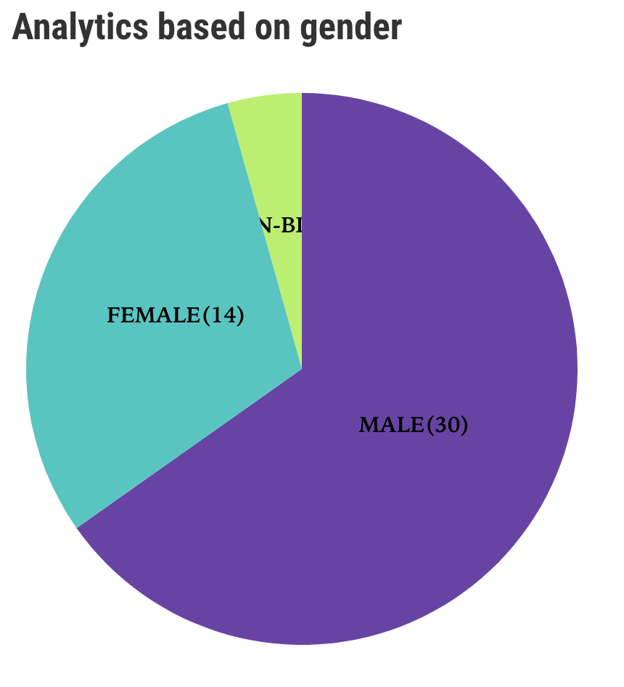
Demo ?
@purnimakamath

Slide 15

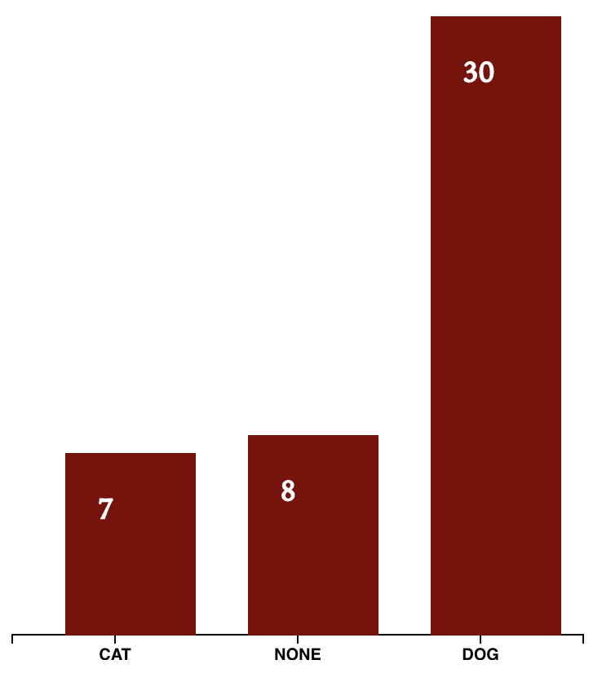
Demo Topology
Cluster**
Broker-1**
WEB_ANALYTICS_IN
IN
KStreams
Microservice
WEB_ANALYTICS_OUT
OUT
KStreams
Device Change Log
Device
State Store
Pet
State Store
Preferred Pet Change Log
Gender Change Log
Gender
State Store
Browser
State Store
Observable Notebook
Browser Change Log
**Simplified for brevity
Topics: 3
Brokers: 5
Partitions for each topic: 12
Replication factor: 3
Notes:
State stores use Chagelogs topics to stay fault tolerant.

Slide 16
Stats & Other things
Kafka in LinkedIn processes 1.4 trillion messages, deployed across 1400 brokers
O’Reilly Strata Conference Singapore – every other talk/project used Kafka!
Netflix uses Kafka in their streaming pipeline (called Keystone). This system processes 2 trillion messages per day!
NYTimes uses Kafka’s distributed log as a source of truth for their article archives

Slide 17


Further reading…
Books
Videos
YOW! Night - Go back to the future with event sourcing & CQRS : https://engineers.sg/v/2793
Building Data Intensive applications : https://www.youtube.com/watch?v=KIiq8lIgUVk
Code & Demo
https://github.com/pkamath2/web-analytics-capture
https://github.com/pkamath2/web-analytics
Demo Notebook: https://beta.observablehq.com/@pkamath2/web-analytics-using-apache-kafka

Slide 18
Further reading…
References used in the slides –
Kafka in LinkedIn - https://engineering.linkedin.com/blog/2016/04/kafka-ecosystem-at-linkedin
Michael Noll’s blog for Kafka streams: https://www.michael-noll.com/blog/2018/04/05/of-stream-and-tables-in-kafka-and-stream-processing-part1/
NY Times on how they use Kafka: https://open.nytimes.com/publishing-with-apache-kafka-at-the-new-york-times-7f0e3b7d2077
Confluent blog on Kafka Streams: https://www.confluent.io/blog/introducing-kafka-streams-stream-processing-made-simple/
Consumer offsets deep dive: https://www.sderosiaux.com/2017/08/07/looking-at-kafka-s-consumers-offsets/

Slide 19
Thank you
@purnimakamath
https://www.linkedin.com/in/purnimakamath/

Slide 20


Slide 21


